Slide 1
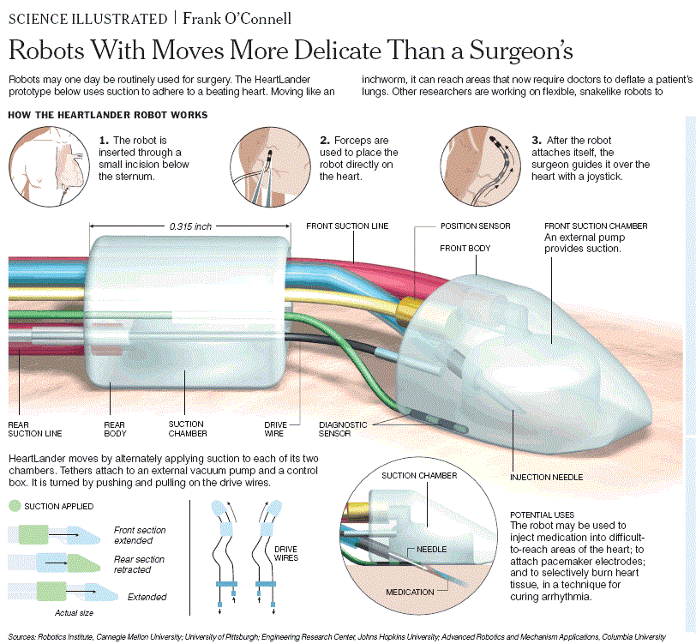
Intelligence?

Slide 2
Adaptable
Pure pursuit-tracking algorithm
Sensors:
position
diagnostic

Slide 3
Limitations
Tethered robot, rigid mobility
Size currently 8mm wide, 5mm tall and about 10mm long
2 Applications
pacing and dye marks

